Slide 1




Distributed Web Security for Science Gateways
Jim Basney jbasney@illinois.edu
In collaboration with: Rion Dooley dooley@tacc.utexas.edu
Jeff Gaynor gaynor@illinois.edu
Suresh Marru smarru@indiana.edu
Marlon Pierce marpierc@indiana.edu
This material is based upon work supported by the National Science Foundation under grant number 1127210.

Slide 2

Distributed Web Security for Science Gateways
Software Development for Cyberinfrastructure grant from the NSF Office of CyberInfrastructure (www.nsf.gov/oci)
3 year project: August 2011 – July 2014
Goal: Support use of OAuth by science gateways for distributed authentication, delegation, and authorization
Develop OAuth “profiles” for science gateway use cases
Getting certificates from MyProxy servers
Both individual and “community” credentials
Delegating certificates between gateway components
Delegated access to REST services
Integration with external authentication (LDAP, Kerberos, SAML, OpenID)
Credential refresh
Web Single Sign-On (OpenID Connect)

Slide 3
Defining Terms
Authentication: Who are you?
customer #83461234987
name: Jim Basney
email: jbasney@illinois.edu
Authorization: What are you allowed to do?
Access private information
Charge purchases to your credit card
Delegated Authorization: Authorizations you grant to others
Park your car (valet key)
View your private photos on Flickr
Collaboratively edit an online Google doc
Credential: How security information is conveyed
Also known as Assertion or Token

Slide 4
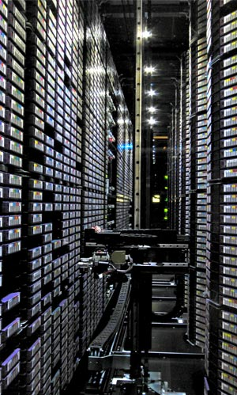
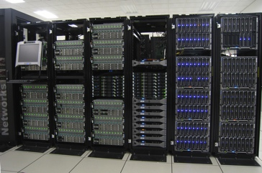
Science Gateways: Tiered Access Models
user authenticates to science gateway
science gateway authenticates to service providers

Slide 5
Science Gateways: Tiered Access Models
Option A: Transitive Trust
Bilateral agreement between science gateway & service provider
Bulk allocation of service to the science gateway
Service provider may not know who the end users are
Users may not know who the underlying service providers are
Example: XSEDE Community Account model
User attributes in community credential provides user info to SP
Option B: Delegation of Rights
End user has account at underlying service provider
Example: Individual XSEDE account with Globus Online
Science Gateway explicitly acts on the user’s behalf when interacting with the underlying service providers
Both options are useful (and can be combined)
Our recent work is focused on Option B: Delegation of Rights

Slide 6
Example: Photo Printing
2
3
Your flickr
Password
Photos
1
Your flickr Password

Slide 7
Example: Using OAuth
Authenticate & Grant Access to Photos
2
3
Token
5
6
Token
Photos
4
Token
1
Request Access to Photos

Slide 8
Example: Science Gateway
2
3
Your
Password
Access
1
Your Password

Slide 9
Delegated Authorization via OAuth
Authenticate & Grant Access
2
3
Token
5
6
Token
Access
4
Token
1
Request Access to Supercomputer

Slide 10
Delegated Authorization via OAuth
Authenticate & Grant Access
2
3
Token
5
6
Token
Data
4
Token
1
Request Access to iPlant Data

Slide 11
OAuth for MyProxy
Provides an OAuth 1.0a compliant REST web interface to MyProxy for providing user certificates to science gateways
Eliminates the need for users to disclose their MyProxy passwords to science gateways. Instead, gateway users authenticate to their MyProxy server’s OAuth web interface to approve issuance of a certificate by MyProxy to the science gateway they are using.
Java client & server implementations available now
http://www.sciencegatewaysecurity.org/oauth-for-myproxy
XSEDE MyProxy OAuth Server
https://portal.xsede.org/oauth/
http://security.ncsa.illinois.edu/teragrid-oauth/
TG11 paper: http://dx.doi.org/10.1145/2016741.2016776
In use today by Globus Online
Supports using individual XSEDE accounts via science gateways

Slide 12
MyProxy Use Case
Old Approach
New Approach

Slide 15
Globus Online Example

Slide 17

Globus Online Example

Slide 20

OOI Example

Slide 22
OOI Example

Slide 24

OOI Example

Slide 26
Starting the Discussion
What are science gateways doing today for web security?
Using OAuth, OpenID, SAML?
Supporting both individual and community accounts?
Authenticating to REST services?
Sharing data across multiple gateways?
What are current/future science gateway security needs?
What is your input on our project plans?
Getting certificates from MyProxy servers
Delegating certificates between gateway components
Delegated access to REST services
Integration with external authentication (LDAP, Kerberos, SAML, OpenID)
OAuth 2.0 update
Credential refresh
Web Single Sign-On (OpenID Connect)
What is your input on the XSEDE architecture?

Slide 27

Continuing the Discussion
Please join our discuss@sciencegatewaysecurity.org mailing list:
Send email to: discuss+subscribe@sciencegatewaysecurity.org
Or visit: https://groups.google.com/a/sciencegatewaysecurity.org/group/discuss/subscribe

